Slide 1
App Download Project
By Interns: Divyansh Chaudhary Bhramar Virmani

Slide 2
Scope Of The Project
To determine whether the end user has the specific Application installed on his mobile device ( IOS/Android ).
Change the Website Banner Content to the appropriate text depending on the installation status of the application.

Slide 3
GetInstalledRelatedApps() API
The getInstalledRelatedApps() makes it possible for your page to check if your mobile or desktop app, or in some cases, if your Progressive Web App (PWA) is already installed on a user's device, and allows you to customize the user experience if it is.

Slide 4
Some Functionality
For example, if app is already installed:
Redirecting the user from a product marketing page directly into your app.
Centralizing some functionality like notifications in the other app to prevent duplicate notifications.
Not promoting the installation of your PWA if your other app is already installed.

Slide 5
How to Use getInstalledRelatedApps()
To use the getInstalledRelatedApps() API, you need to tell your app about your site, then tell your site about your app. Once you've defined the relationship between the two, you can check if the app is installed.
NOTE: The getInstalledRelatedApps() API only allows you to check if your apps are installed. You cannot get a list of all installed apps, or check if other 3rd party apps are installed.

Slide 6
1st Step: Tell Android App About the Website
First, you'll need to update your Android app to define the relationship between your website and Android application using the Digital Asset Links system.
This ensures that only your website can check if your Android app is installed.

Slide 7
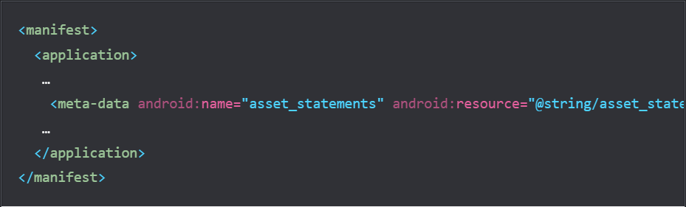
AndroidManifest.xml Changes
In the AndroidManifest.xml of our Android app, add an asset_statements entry:

Slide 8
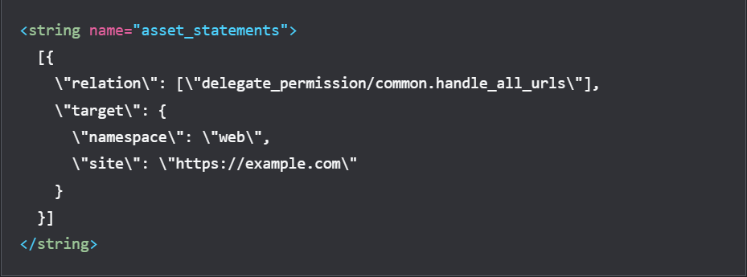
Strings.xml Changes
Then, in strings.xml, add the following asset statement, updating site with our domain. We need to include the escaping characters. For example:

Slide 9
2nd Step: Tell your Website About Your Android App
Next, tell our website about our Android app by adding a web app manifest to your page. The manifest must include the related_applications property, an array that provides the details about our app, including platform and id.
platform must be play
id is the Google Play application ID for your Android app

Slide 10
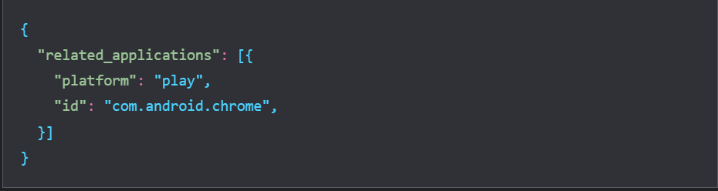
Example

Slide 11
3rd Step: Check if your App is Installed
Finally, call navigator.getInstalledRelatedApps() to check if your Android app is installed.
Some Demo Code Snapshots of the following files used while implementing: 1.) Common.js 2.) Demo.js

Slide 12
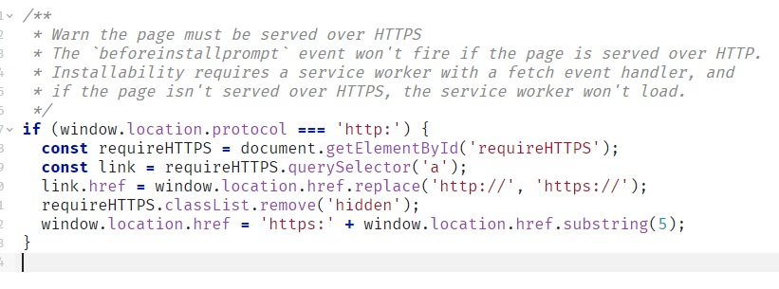
Common.js

Slide 13
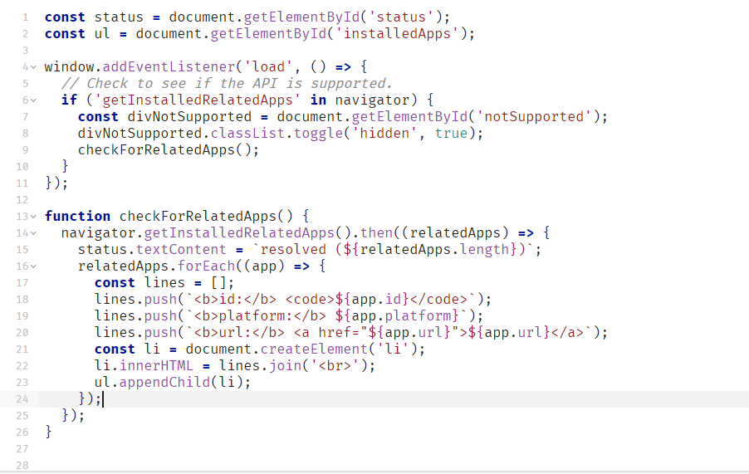
Demo.js

Slide 14
Expected Output

Slide 15
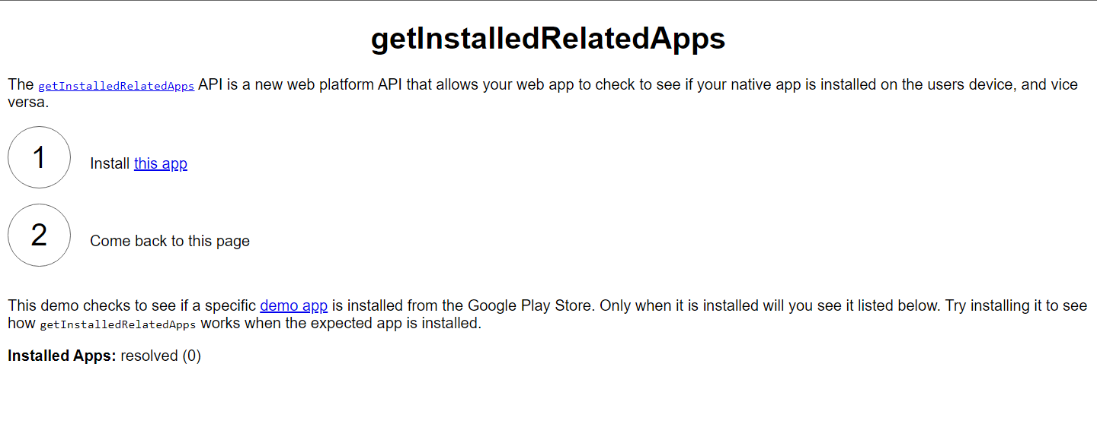
Before App Installation

Slide 16
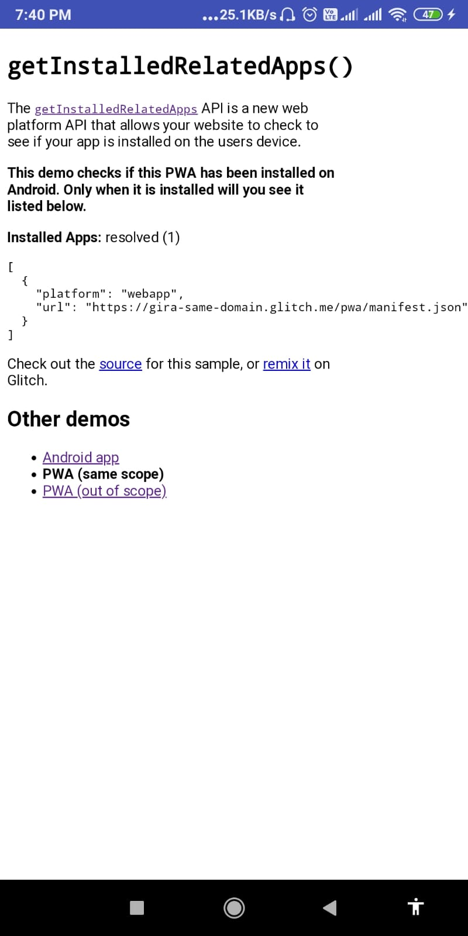
After App Installation (incase of PWA)

Slide 17
Solution For IOS Devices

Slide 18
Apple’s Smart Banner
If the app is already installed on a user’s device, the Smart App Banner intelligently changes its action, and tapping the banner simply opens the app.
If the user doesn’t have your app on their device, tapping the banner takes them to the app’s entry in the App Store.
When they return to your website, a progress bar appears in the banner, indicating how much longer the download will take to complete.
When the app finishes downloading, the View button changes to an Open button, and tapping the banner opens the app while preserving the user’s content from your website.

Slide 19
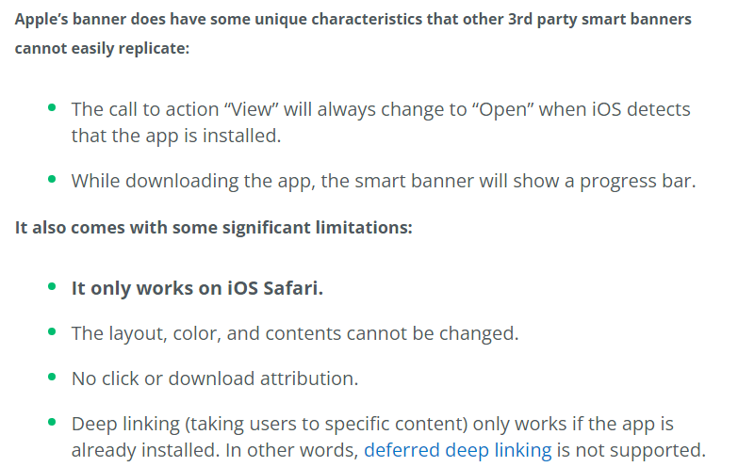
Apple’s Smart Banner Contd.

Slide 20
Expected Outputs

Slide 21
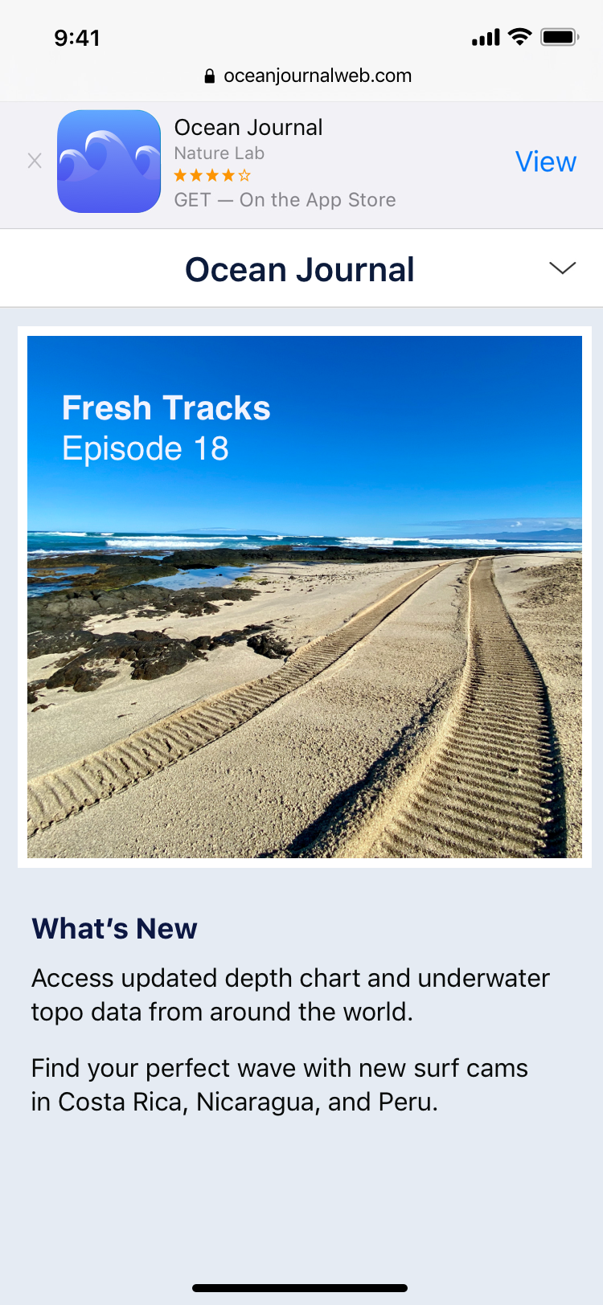
Before App Installation

Slide 22
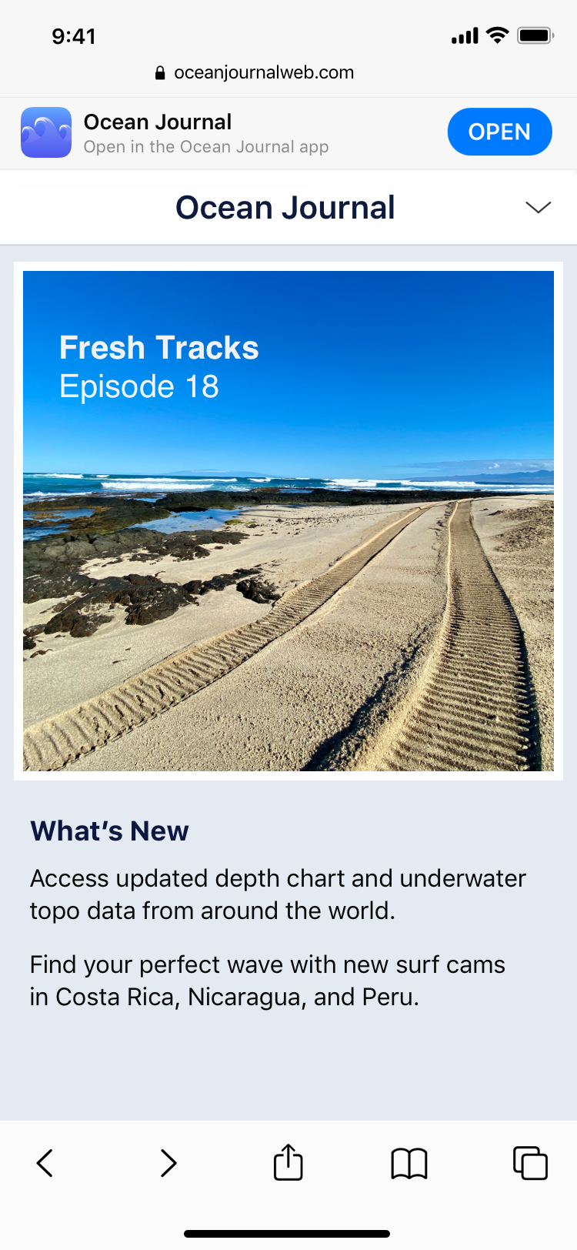
After App Installation

Slide 23
References
GetInstalledRelatedApps() API: https://web.dev/get-installed-related-apps/
Apple Smart-Banner Documentation: https://developer.apple.com/documentation/webkit/promoting_apps_with_smart_app_banners

Slide 24
Thank You !!

